Slide 1
Session Management
Waqar Yar

Slide 2
Topics covered today
Conversation with Client
Cookies
URL Rewriting.

Slide 3
Conversation with a Client.
We can use a session object to store data for a client conversation.
HttpSession object can hold conversational state across multiple requests from the same client.
It persists for an entire session with a specific client.

Slide 4
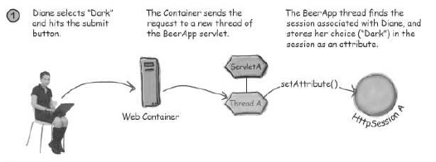
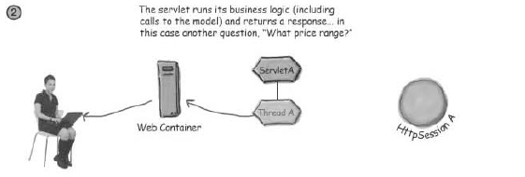

Slide 5
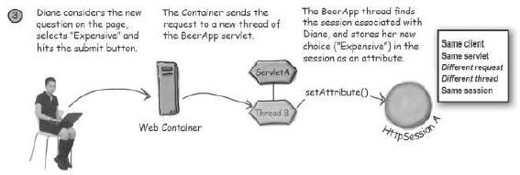
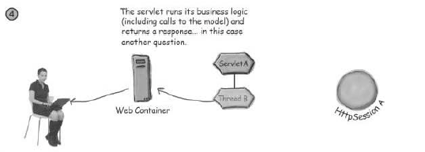

Slide 6
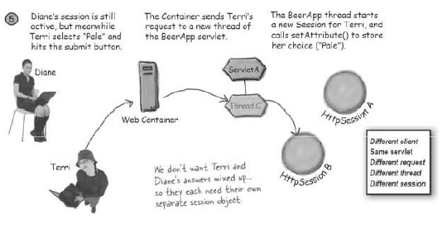
How Does a Session Object know which User it belongs to?

Slide 7
How Does a Session Object know which User it belongs to?
On the first client request, the Container generates a unique session ID.
This session ID is given back to the Client with a response.
The Client send back the session ID with each subsequent request.

Slide 8
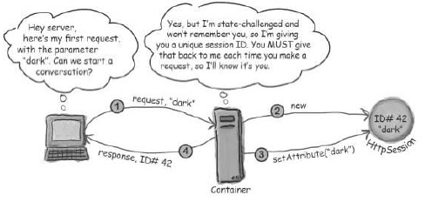
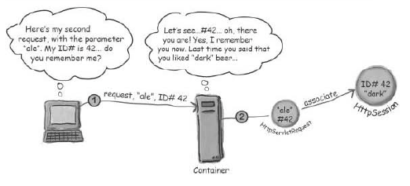

Slide 9
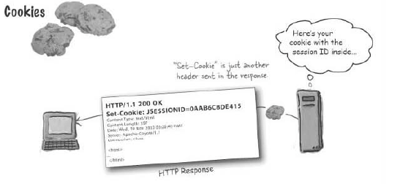
Cookies..

Slide 10
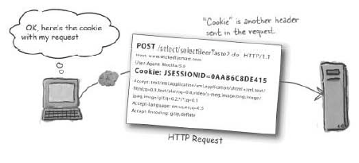
Cookies identify the session.

Slide 11
How does the Container manages a session.
HttpSession session = request.getSession();
The first time a session is requested the container does the following:
Creates the HttpSession Object.
Generates the unique session id.
Creates a new Cookie object.
Associates the Cookie with the session object.
Sets the Cookie in the response object.

Slide 12
How does the Container manages a session.
If the session already exists for a Client following are the steps it takes to manage it:
IF(the request includes a session ID cookie)
find the session matching that ID
ELSE IF( there is no session ID cookie OR there is no current session matching the session ID)
create a new session.

Slide 13
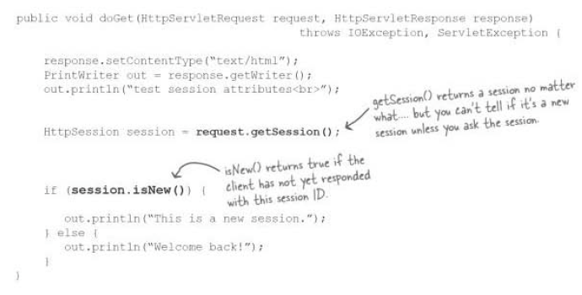
To check if session is New

Slide 14
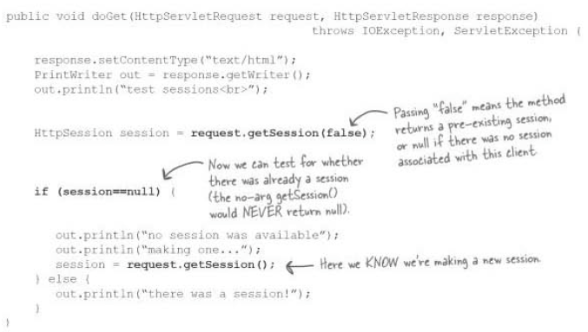
To check if a session is pre-existing.

Slide 15
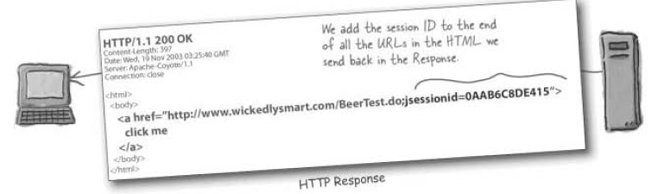
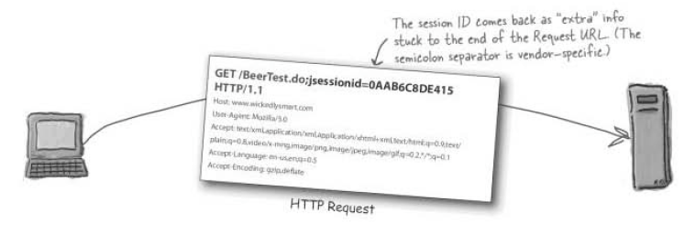
URL Rewriting

Slide 16
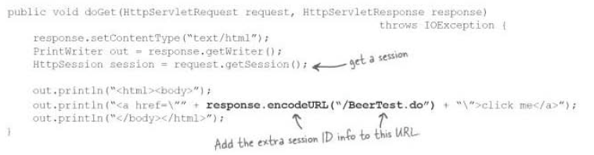
URLrewriting example
If cookies are not allowed, and url is not encoded then sessions will not work.
The Container always tries to do Cookies first for session management.
If Cookies are disabled then URL encoding is looked at by the container.

Slide 17
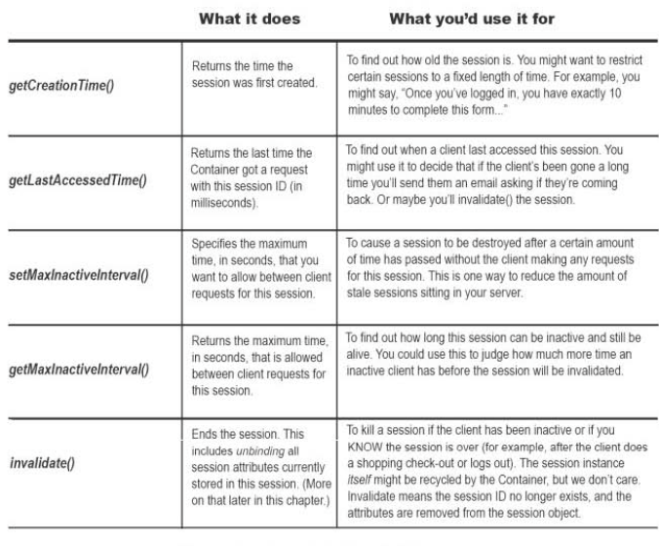
Session methods

